Slide 1
Power Electronics (DC-DC) Converters in E-mobility
Dr. Sachin Argade

Slide 2
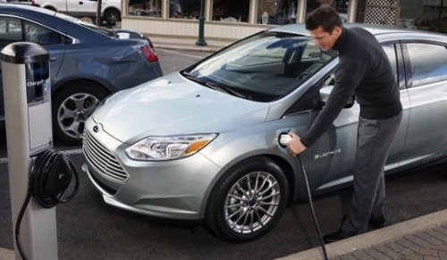

Electric Vehicles (EVs) and Charging
Level Of Charging | Description
Level 1 | Ideal for single phase connection. Slow charging.
Level 2 | Household charging with 2 phase connection. Fast charging .
Level 3 | Fastest among all charging levels. DC charging.

Slide 3
Role of Emobility Engineers
Knowing construction of PEV, HEV etc
knowing working of PEV, HEV etc
Knowing EV charging Issues on Power System

Slide 4
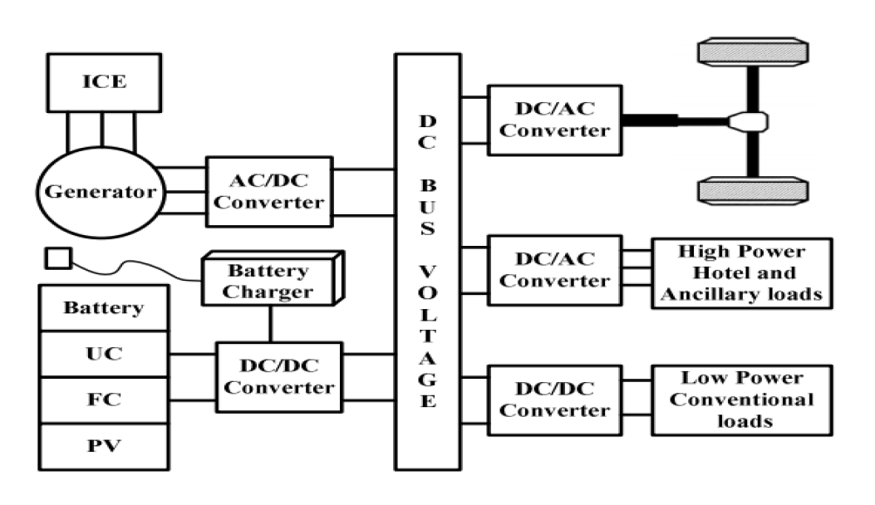
Power Electronic Converter

Slide 5
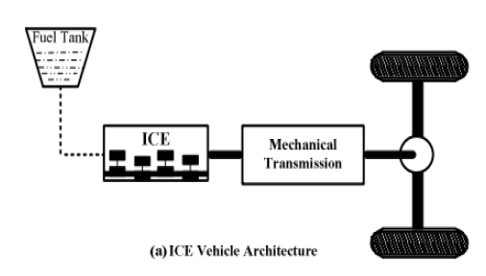

Slide 6
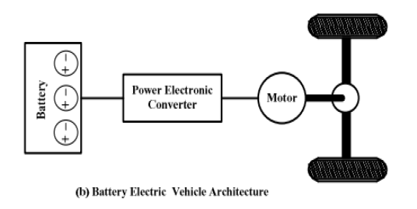

Slide 7
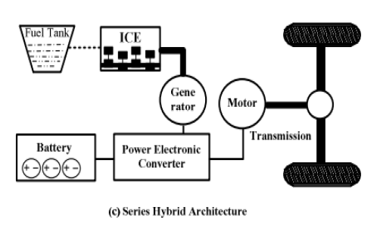

Slide 8
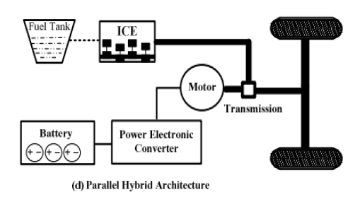

Slide 9
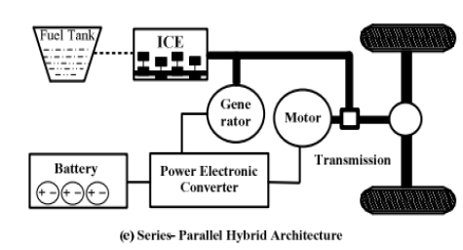

Slide 10
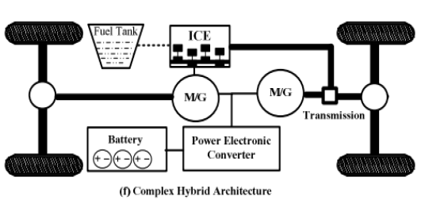

Slide 11
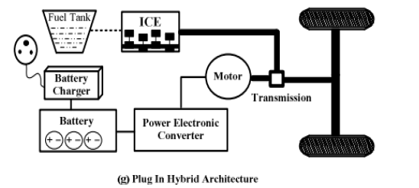

Slide 12
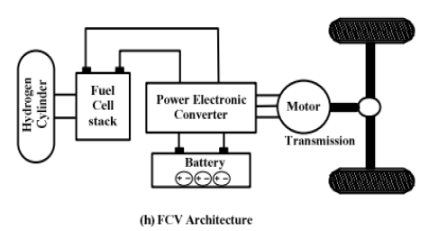

Slide 13
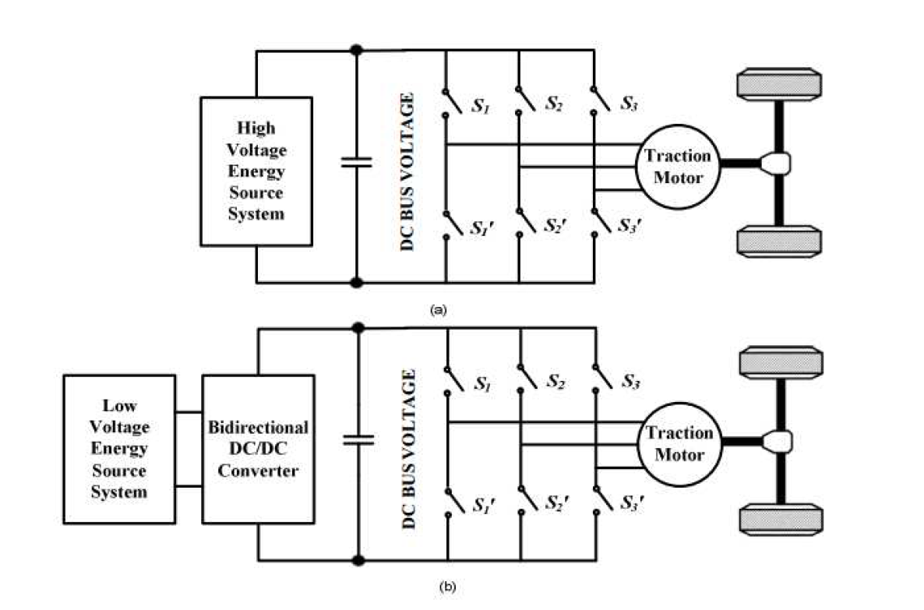

Slide 14
A DC/DC converter in its basic form converts unregulated DC input voltage at a certain level to a regulated DC output voltage at a different level with very high conversion efficiency (>90%).
Modern day DC/DC converters are operated at high frequencies (10 kHz - 1 MHz).
The size of the components such as inductors, transformers, and capacitors are reduced at high frequency operation
Transistors such as MOSFETs and IGBTs are used as switches.
is preferred in low
frequency high power applications
is preferred in low
frequency high power applications

Slide 15
Selection and design considerations of DC/DC converters are important factors
DC/DC Converter
Output voltage regulation
Controlling power flow between source and load

Slide 16
DC/ DC Converter
Providing low voltage (12V or 14V) for low voltage loads.
Boosting the voltage level of the battery
Motor propulsion if the traction motor is a DC motor.
To match voltage of DC bus voltage

Slide 17
42 V
300 V and Higher
6V
12 V
Need For PEC

Slide 18
Inefficient DC−DC converter
R₁
The load
+
V_{in}
−
+
V_{out}
−
R₂
If V_{in} = 15V, and V_{out} = 5V, efficiency η is only 0.33
Unacceptable except in very low power applications

Slide 19
A lossless conversion of 15Vdc to average 5Vdc
voltage
Switch closed
Switch open
15
0
+
15Vdc
–
R
Switch state, voltage
Closed, 15Vdc
Open, 0Vdc
DT
T
If the duty cycle D of the switch is 0.33, then the average voltage to the expensive car stereo is 15 ● 0.33 = 5Vdc. This is lossless conversion, but is it acceptable?

Slide 20
Convert 15Vdc to 5Vdc, cont.
Try adding a large C in parallel with the load to control ripple. But if the C has 5Vdc, then when the switch closes, the source current spikes to a huge value and burns out the switch.
+
15Vdc
–
C
Rstereo
L
Try adding an L to prevent the huge current spike. But now, if the L has current when the switch attempts to open, the inductor’s current momentum and resulting Ldi/dt burns out the switch.
+
15Vdc
–
C
Rstereo
lossless
L
By adding a “free wheeling” diode, the switch can open and the inductor current can continue to flow. With high-frequency switching, the load voltage ripple can be reduced to a small value.
+
15Vdc
–
C
Rstereo
A DC-DC Buck Converter

Slide 21
Steady-state analysis of the Buck converter in CCM (I)
Step 1: Main waveforms. Remember that the output voltage remains constant during a switching cycle if the converter has been properly designed
i_{g}
v_{S}
i_{S}
i_{L}
i_{O}
+
-
Driving signal
i_{D}
L
C
+
S
+
v_{D}
R_{L}
v_{O}
t
v_{g}
-
-
D
i_{L}
i_{L}
i_{O}
t
S on, D off
L
C
+
v_{O}
i_{S}
v_{g}
R_{L}
-
t
During dT
i_{L}
i_{O}
i_{D}
t
S off, D on
L
C
+
R_{L}
v_{O}
dT
-
T
During (1-d)T

Slide 22
Steady-state analysis of the Buck converter in CCM (II)
Step 1: Main waveforms
+
v_{L}
Driving signal
v_{S}
i_{L}
-
i_{O}
+
-
+
L
C
+
t
S
v_{D}
v_{O}
i_{L}
v_{g}
R_{L}
-
D
-
Δi_{L}
i_{L_avg}
t
+
v_{L}
i_{L}
-
i_{O}
v_{L}
S on, D off,
dT
v_{g}-v_{O}
L
C
+
t
R_{L}
v_{O}
v_{g}
-
- v_{O}
dT
T
+
v_{L}
i_{L}
-
i_{O}
S off, D on,
(1-d)T
L
C
+
From Faraday’s law:
Δi_{L} = v_{O}(1-d)T/L
R_{L}
v_{O}
-

Slide 23
Can we obtain either v_{O} < v_{g} or v_{O} > v_{g} ⇒ Buck-Boost converter
i_{g}
i_{S}
i_{D}
i_{O}
Driving signal
i_{L}
D
+
-
-
t
S
v_{O}
v_{L}
C
+
R_{L}
+
v_{g}
L
-
i_{L}
Δi_{L}
i_{g}
t
+
i_{S}
i_{L}
S on, D off,
during dT
v_{L}
v_{g}
t
L
-
Charging stage
i_{D}
i_{O}
t
i_{L}
+
dT
S off, D on,
during (1-d)T
C
-
-
v_{L}
R_{L}
v_{O}
T
L
+
+
-
From Faraday’s law:
Δi_{L} = v_{g}dT/L
Discharging stage

Slide 24
Can we obtain v_{O} > v_{g}? ⇒ Boost converter
Step 1: Main waveforms
Driving signal
i_{g}
+
v_{L}
i_{D}
-
i_{L}
i_{O}
t
L
i_{S}
D
+
+
i_{L}
R_{L}
v_{O}
Δi_{L}
v_{g}
S
C
-
-
t
i_{S}
+
v_{L}
i_{L}
-
S on, D off,
during dT
t
L
v_{g}
i_{D}
t
+
v_{L}
dT
i_{L}
-
i_{O}
T
S off, D on,
during (1-d)T
L
C
+
R_{L}
v_{O}
From Faraday’s law:
Δi_{L} = v_{g}dT/L
-

Slide 25
The Switch is ON and represents a short circuit
All the current will flow through the switch and the inductor and back to the DC input source.
The inductor stores charge during the time the switch is ON
i_{g}
i_{S}
i_{D}
i_{O}
i_{g}
i_{L}
D
i_{L}
+
+
-
-
S on, D off,
during dT
v_{L}
S
v_{O}
v_{g}
v_{L}
C
+
R_{L}
+
L
-
v_{g}
L
-
Charging stage

Slide 26
when the solid state switch is OFF the polarity of the Inductor reverses
so that current flows through the load and through the diode and back to the inductor.
So the direction of current through the inductor remains the same.
This also step-up the output voltage as the inductor is now also acting as a source in conjunction with the input source.
i_{g}
i_{S}
i_{D}
i_{O}
+
v_{L}
i_{L}
-
i_{O}
i_{L}
D
+
-
-
S off, D on,
during (1-d)T
L
C
+
S
v_{O}
v_{O}
v_{L}
C
+
R_{L}
+
R_{L}
v_{g}
L
-
-

Slide 27
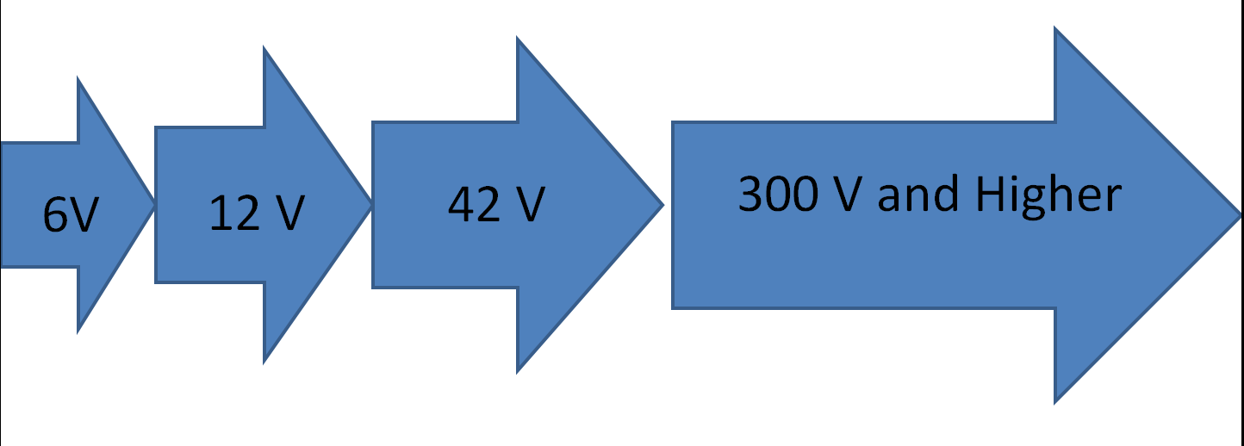
DC/DC Converters used for boosting the battery voltage
AC motors in EVs and HEVs are fed by inverters which in-turn is fed by a high voltage DC/DC converter.

Slide 28
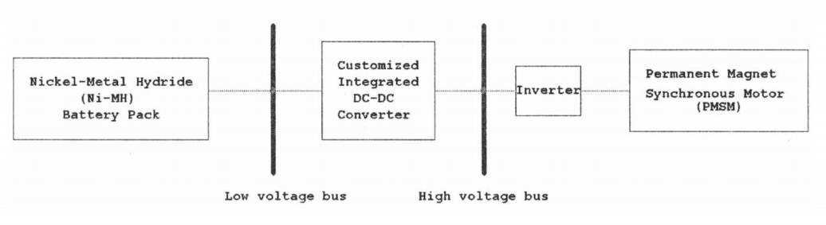
As an example, in Toyota Prius the low voltage bus is at 201.3 V Nickel-Metal Hydride (Ni-MH) battery output, which is converted to 500 V by a simple boost converter to feed a 50KW (1200-1540 rpm) PMSM

Slide 29
Unidirectional DC/ DC Converters
Bidirectional DC/ DC Converters
various onboard loads such as
sensors, controls, entertainment, utility, and safety equipment
battery charging, regenerative braking, and backup power

Slide 30
Bidirectional converter is usually from a low voltage end such as battery or a super capacitor to a high voltage side and is referred to as boost operation
During regenerative braking, the power flows back to the low voltage bus to recharge the battery (buck mode).
the bidirectional
DC/DC converter facilitates the safe operation of the vehicle when ICEs or electric drives fail to drive the motor.

Slide 31
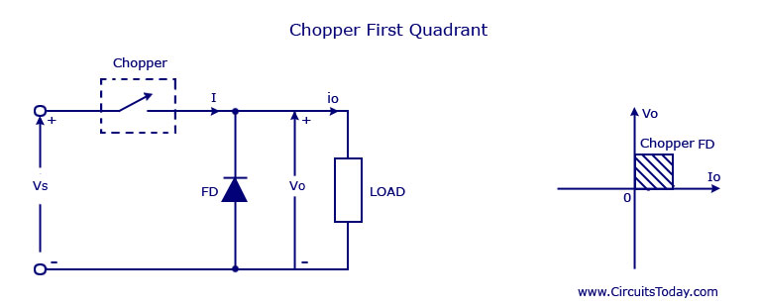
A DC chopper is a static device that converts fixed dc input voltage to a variable dc output voltage directly.
Type A – First Quadrant
When the chopper is on, v₀ ₌ V_{S} as a result and the current flows in the direction of the load
But when the chopper is off v₀ is zero but I₀ continues to flow in the same direction through the freewheeling diode FD

Slide 32
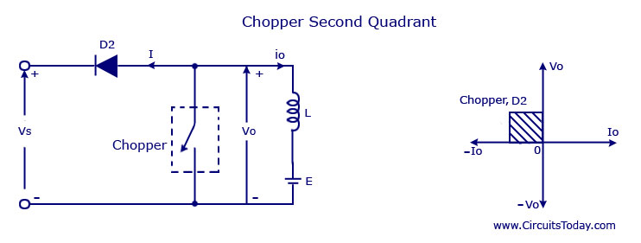
Type B Second Quadrant operation
In type B or second quadrant chopper the load must always contain a dc source E
When the chopper is on, v₀ is zero but the load voltage E drives the current through the inductor L and the chopper
L stores the energy during the time T_{on} of the chopper
When the chopper is off , v₀ will be more than the source voltage V_{s}
Because of this the diode D2 will be forward biased and begins conducting
The power starts flowing to the source

Slide 33
Type B Second Quadrant operation
No matter the chopper is on or off the current I₀ will be flowing out of the load and is treated negative
Since V_{O} is positive and the current I₀ is negative , the direction of power flow will be from load to source.
The load voltage V₀ will be more than the voltage V_{s} so the type B chopper is also known as a step up chopper .

Slide 34
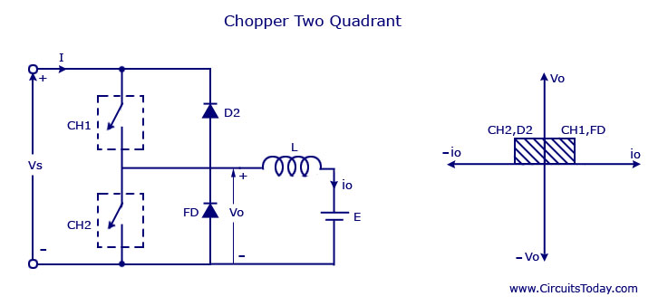
Type C chopper is obtained by connecting type –A and type –B choppers in parallel.
We will always get a positive output voltage V₀ as the freewheeling diode FD is present across the load.
When the chopper is on the freewheeling diode starts conducting and the output voltage v₀ will be equal to V_{s}
The direction of the load current i₀ will be reversed.
The current i₀ will be flowing towards the source and it will be positive regardless the chopper is on or the FD conducts.
The load current will be negative if the chopper is or the diode D2 conducts.
chopper and FD operate together as type-A chopper
In the second quadrant, the chopper and D2 will operate together as type –B chopper
The average voltage will be always positive but the average load current might be positive or negative.
For regenerative braking and motoring these type of chopper configuration is used.

Slide 35
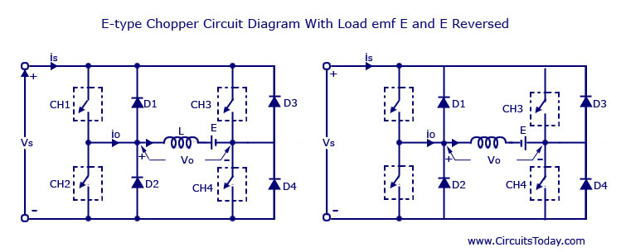
First Quadrant : During the first quadrant operation the chopper CH4 will be on . Chopper CH3 will be off and CH1 will be operated.(Step Down)
Second Quadrant In this case the chopper CH2 will be operational and the other three are kept off. (Step up)
In third quadrant operation CH1 will be kept off , CH2 will be on and CH3 is operated. (Step Down)
In Fourth Quadrant CH4 will be operated and CH1, CH2 and CH3 will be off. (Step up)

